Slide 1

Lesson no 4
ELECTRONIC WARFARE FUNDAMENTALS

Slide 2
01. Introduction
02. Electronic Support (ES)
03. Electronic Attack (EA)
CONTENTS
04. Electronic Defense (ED)

Slide 3
01. Introduction

Slide 4
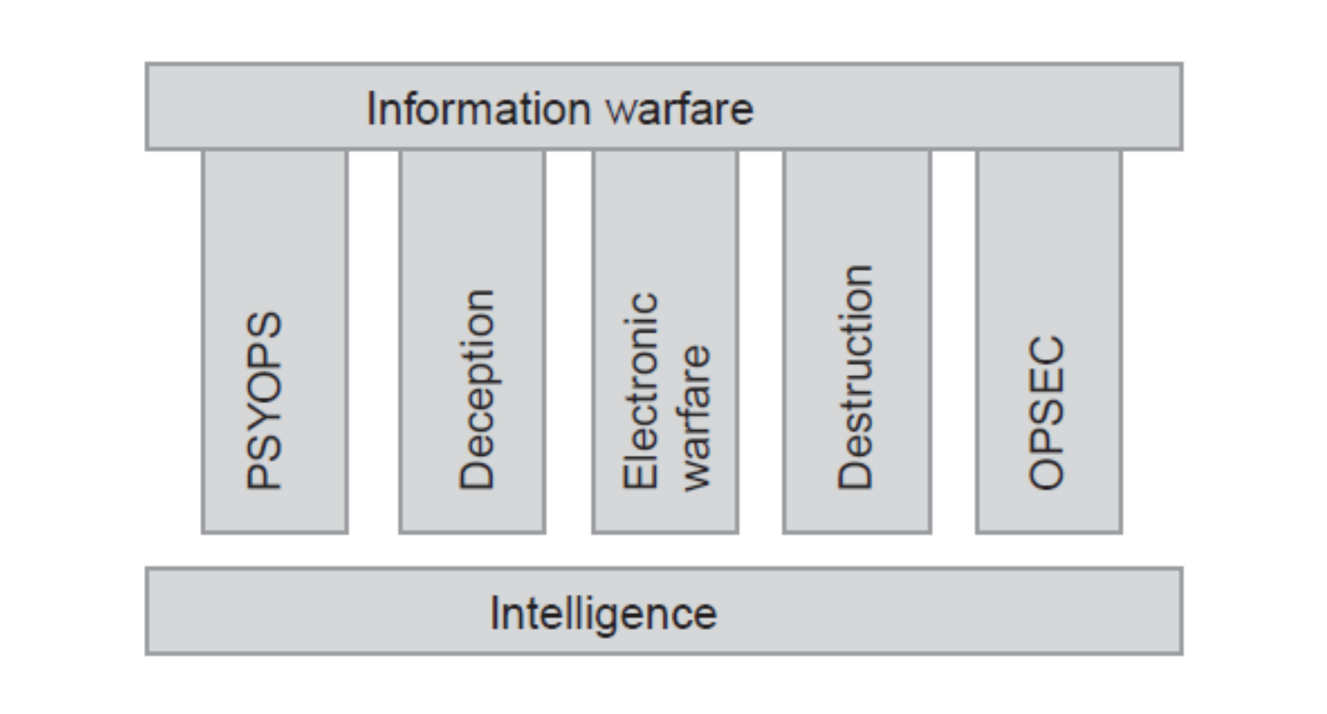

Slide 5
Electronic Warfare (EW) – is defined as the operating military action involving the exploitation of the electromagnetic spectrum which presupposes
the interception and identification of emission,
electromagnetic energy engagement, including the directed energy,
while reducing or preventing hostile actions within the electromagnetic spectrum.

Slide 6
In the information era, military relies heavily on the use of the electromagnetic spectrum for
  communications,
  electronics,
  surveillance,
  navigation,
  weapons systems,
  own protection, etc.
The dominance of the electromagnetic spectrum is a crucial component of military operations in the information age, based on intensive use of information systems and electronic communication in general.

Slide 7
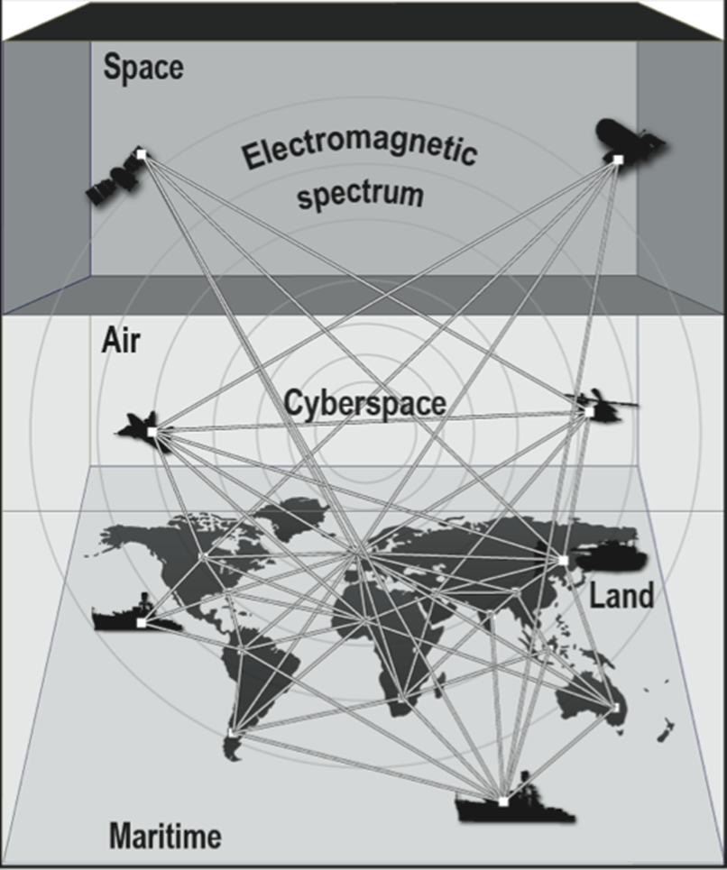

Slide 8
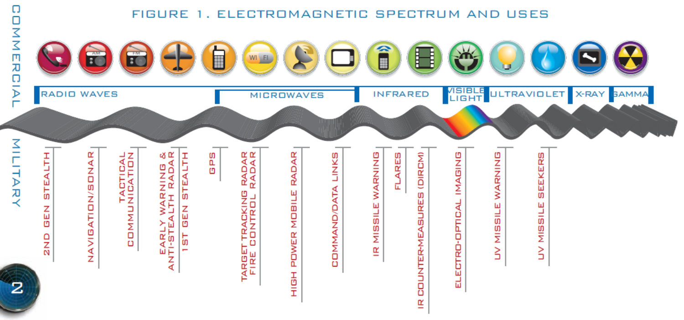

Slide 9
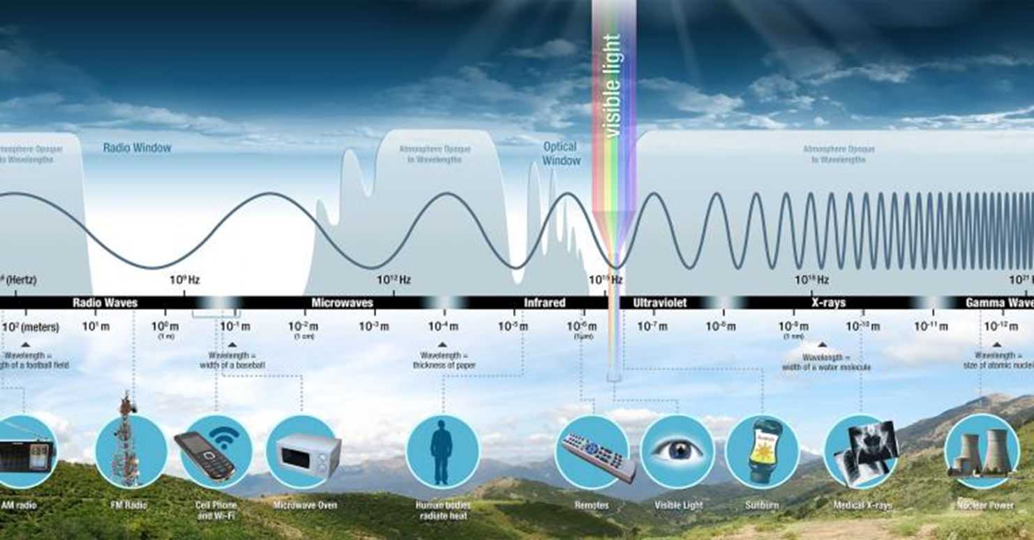

Slide 10
Electronic warfare actions are electromagnetic operations specific to electronic warfare that produce effects in the electromagnetic environment and provide operational support.
These actions are:
      - Electronic Support – ES
      - Electronic Attack - EA
      - Electronic Defense - ED

Slide 11
02. Electronic Support (ES)

Slide 12
Electronic support – ES – represents the activity of exploiting the electromagnetic energy for situational awareness and for information gathering.
Electronic support is focused on providing knowledge of the electronic situation at any time and of cues and warnings on the activities of the electromagnetic environment.

Slide 13


Slide 14
03. Electronic Attack (EA)

Slide 15
Electronic attack involves the use of
electromagnetic energy,
directed energy or
antiradiation weapons
to attack personnel, facilities and equipment intended to degrade, neutralize or destroy the enemy’s fighting ability, being considered a form of "fire".

Slide 16
The most common used type is the electronic jamming attack.
This is an action of disturbance destined for total or performant disruption, of systems that process information provided by radio receiver,
by other signals from one or more transmitters which use an identical carrier frequency (or very close to the useful signal carrier frequency)
or by electromagnetic disturbances that overlap useful information.

Slide 17


Slide 18
Electronic attack EA includes
    directed energy weapons DEWs,
    high power microwaves HPM,
    electromagnetic pulse EMP and
    radiofrequency devices RF

Slide 19
04. Electronic Defense (ED)

Slide 20
Electronic Defense – ED represents the actions taken to ensure effective capacity utilization, for self-interest of the electromagnetic spectrum when EW specific means are used by the enemy.
ED consists in those passive or active measures taken to protect
- personnel,
- facilities or
- equipment
from the effects of electronic warfare actions that
- reduce,
- cancel or
- destroy
their combat capabilities.

Slide 21


Slide 22
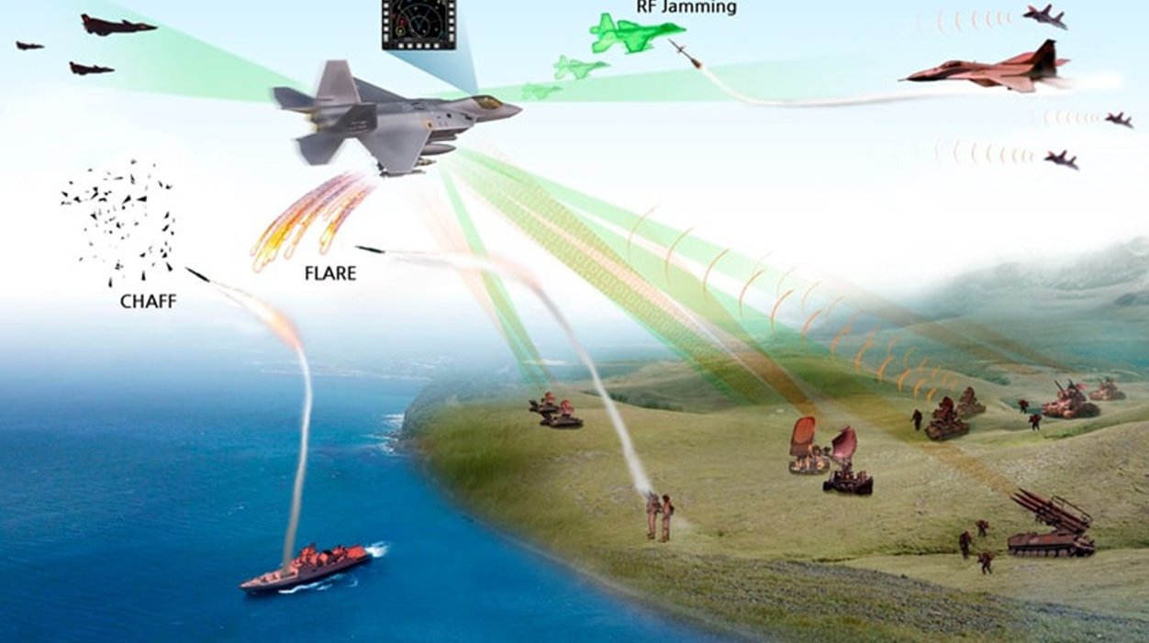

Slide 23
Thanks

